Slide 1



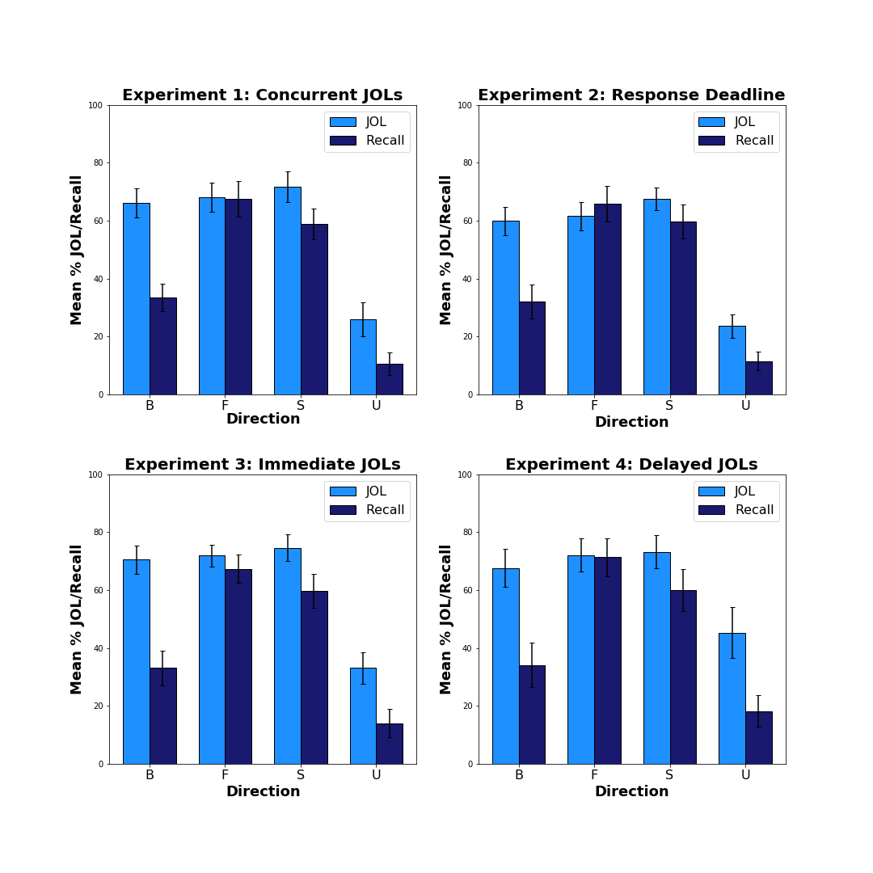
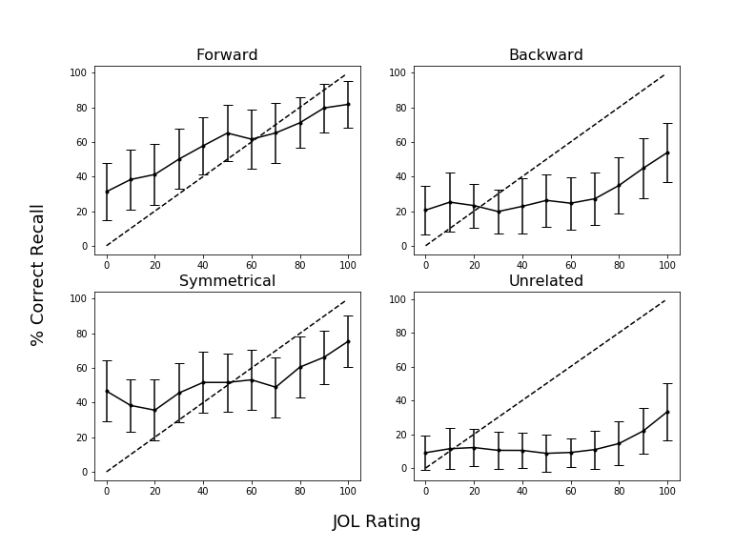
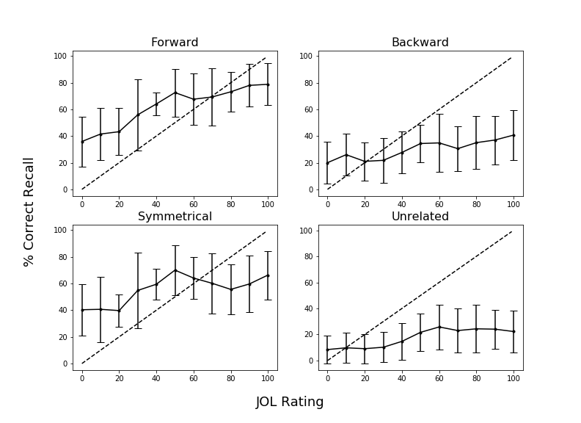
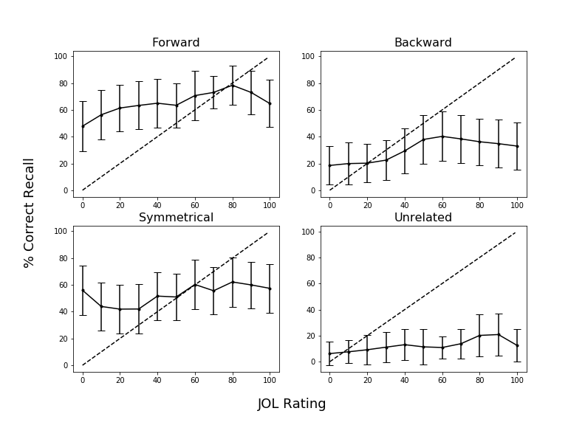
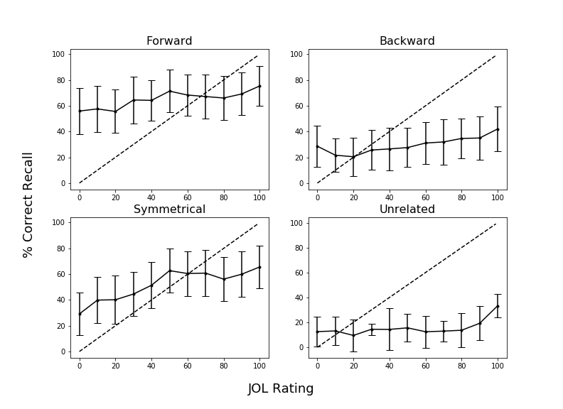
Relations are not Always Beneficial: The Effect of Associative Direction on Judgments of Learning
Nicholas P. Maxwell & Mark J. Huff
Introduction
Examining the relationship between one’s predicted versus actual memory performance is the primary goal of metamemory researchers. A common method for examining this relationship is instructing participants to provide judgments of learning (JOLs) in which participants rate the probability that they will be able to later recall a target word from a studied cue-target pair (e.g., bank-interest) when only a cue word is provided at test (e.g., bank-______).
JOL accuracy is sensitive to the strength of the association between the cue-target pairs as well as the direction of the association. Koriat and Bjork (2005) showed that when forward associative pairs are studied (e.g., red-hot), JOLs are well calibrated to later recall accuracy. However, an Illusion of Competence was found for backward associative pairs (e.g., hot-red) in which JOL estimates exceeded later cued recall rates, a pattern that also extends to identical item pairs (Castel, McCabe, & Roediger, 2007).
The present study builds upon previous findings by comparing asymmetric forward and backward associates to symmetrical associates (e.g., on-off) and unrelated pairs (e.g., cat-pencil) to more closely examine the role of associative direction on JOLs and cued-recall accuracy across several experimental manipulations. Additionally, we provide calibration plots, which plot JOL ratings as a function of recall accuracy to determine whether the calibration between JOLs and recall depends upon the relative JOL rating that is provided.
In Experiment 1, participants made JOLs concurrently with study. Experiment 2 introduced a 5 second response deadline which limited the amount of time subjects spend encoding item pairs. Experiment 3 used a classic immediate JOL manipulation in which JOLs were elicited immediately following study. Finally, Experiment 4 employed a delayed JOL task in which participants solved arithmetic problems in between pair study and when judgments were elicited.
Results
Calibration Cont.
Experiment 3
Experiment 4
Bars = 95% CI
Bars = 95% CI
Calibration
Experiment 1
Note: Overestimation is represented by points falling below the calibration line.
Materials
Conclusions
Replicating previous work, Experiment 1 showed that JOL ratings for backward pairs exceeded later recall accuracy—an illusion of competence. A similar pattern was found for symmetrical and unrelated pairs, though the pattern was less robust. Forward pairs in contrast, were well calibrated. Calibration plots indicated that JOL overconfidence similarly differed across pair types with symmetrical and forward overconfidence only occurring for relatively high JOL ratings (80% or greater), whereas backward and unrelated pairs showed JOL overconfidence at much lower ratings.
Experiment 2 examined whether including a deadline for study and JOL ratings would affect JOL/Recall calibration. While it was expected that less time spent at encoding should result in fewer items correctly recalled (thus increasing the illusion of competence), findings from Experiment 2 do not support this. Instead, we conclude that the high calibration of forward pairs makes them resistant to illusions of competence, even when limited time is allocated for study and judgment making. Experiment 3 showed that these findings extend when using a more traditional immediate JOL task. Finally, Experiment 4 tested whether using a delayed JOL manipulation would reduce the illusion of competence by resulting in greater calibration between JOL ratings and recall. It was expected that making JOLs after a delay would improve calibration (i.e., a delayed JOL effect; Dunlosky & Nelson, 1994). However, our findings do not support this as Experiment 4 still displayed an illusion of competence.
Our analyses improve upon existing work (e.g., Koriat & Bjork, 2005; Castel et al., 2007) by assessing the relationship between JOLs and accuracy across JOL ratings and by controlling for potential item effects that may have clouded data interpretations in previous work. Our data indicate that both forward and backward associations are perceived and that participants provide similar JOLs for both types, but backward associates provide less effective cues at test and participants do not adjust their JOLs. Future work will evaluate other means to improve JOL/recall accuracy calibration by training participants about how backward associates can mislead memory estimates.
Forward Pairs
Wage – Money
Editor – News
Way – Out
Credit – Card
Backward Pairs
Money – Wage
News – Editor
Out – Way
Card – Credit
Symmetrical Pairs
Due – Assignment
Shoe – Foot
Honey – Bee
Circle – Round
Unrelated Pairs
Park – Hungry
Soon – Belt
Discover – Floor
Artery – Bronze
40 pairs were created for each associative direction type using the Nelson et al. (2004) free association norms. All study blocks were matched on FSG, length, concreteness, and frequency.
Experiment 2
Bars = 95% CI
General Method
Study/JOL:
JOL Ratings
(0-100 Scale)
Forward, Backward, Unrelated, and Symmetrical Pairs
Test:
Cued-Recall
Filler Task
Experiment 1: Concurrent JOLs
Experiment 3: Immediate JOLs
Experiment 2: Response Deadline
Note: Overestimation is represented by points falling below the calibration line.
Experiment 4: Delayed JOLS
Correspondence can be addressed to nicholas.maxwell@usm.edu. More info available at: https://osf.io/hvdma/| www.github.com/npm27

